Slide 1
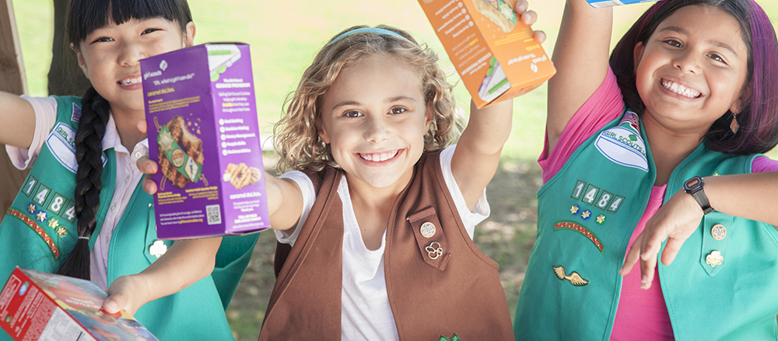
Digital Cookie 4.0
Family/SU/Troop Training

Slide 2
Agenda
Why Digital Cookie?
Setting Up Digital Cookie for a Girl
Registration Issues
Customer View
Troop Leader/SU views
Notes:
Tonight we will go through the set up process for a girl, what to do if you have problems registering, what the customer sees and what Volunteers will see.

Slide 3
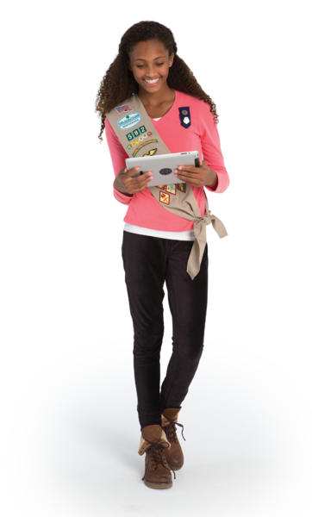
GSHH Girls’ Digital Success
Almost one-quarter of our girls used Digital in 2017
Average sale was 6.7 boxes
Average number of orders online: 6
Girls using Digital sold about 40 boxes online
Notes:
Before we get into the how-to we thought you’d like to know just how successful the program was last year.

Slide 4
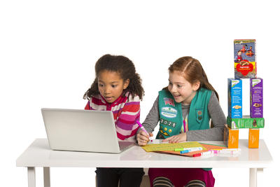
Digital Options
Girls can take orders thru March 11 to deliver to customers in April.
Customers can donate to our military donation program, Operation Cookie Drop
Customers can order, pay shipping and receive cookies within a week of ordering.
Notes:
Girl can take orders to deliver—the site customers choose “IN PERSON DELIVERY”
Customers can donate to OP Drop, our council program that has donated upwards of 100,00 boxes to our military serving abroad, in hospitals, etc.
Customers can also choose to buy cookies now and have them shipped to their homes for can’t wait for cookies!
Customers can also choose to combine options, and donate as well as have cookie shipped or delivered

Slide 5

Working throughout the Cookie Season
…Digital Cookie is open 24/7 Feb 9 thru May 6

Slide 6
Setting up Digital Cookie
Information for Families
Notes:
Let’s start with getting a girl set up in Digital Cookie.

Slide 7
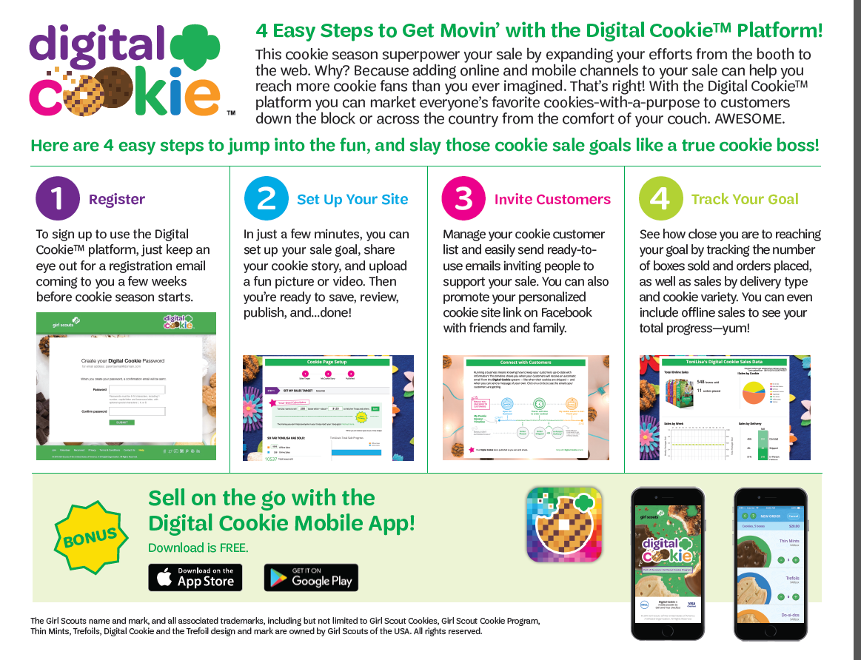
4 Easy Steps
Notes:
It’s really pretty simple – here are the 4 easy steps. Register, Set up the Site, Invite Customers, Track your progress

Slide 8
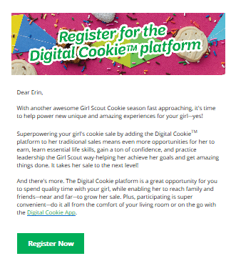
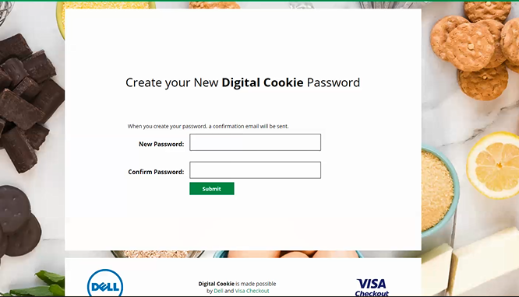
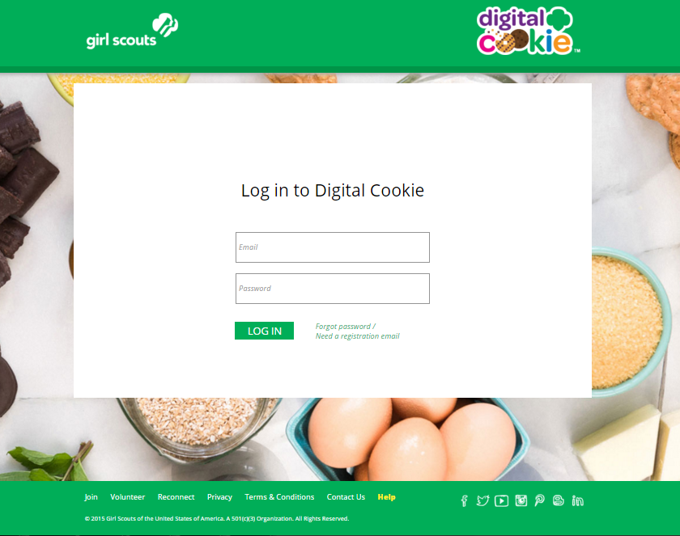
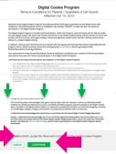
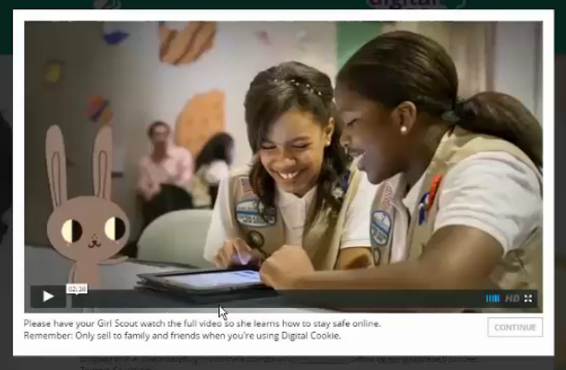
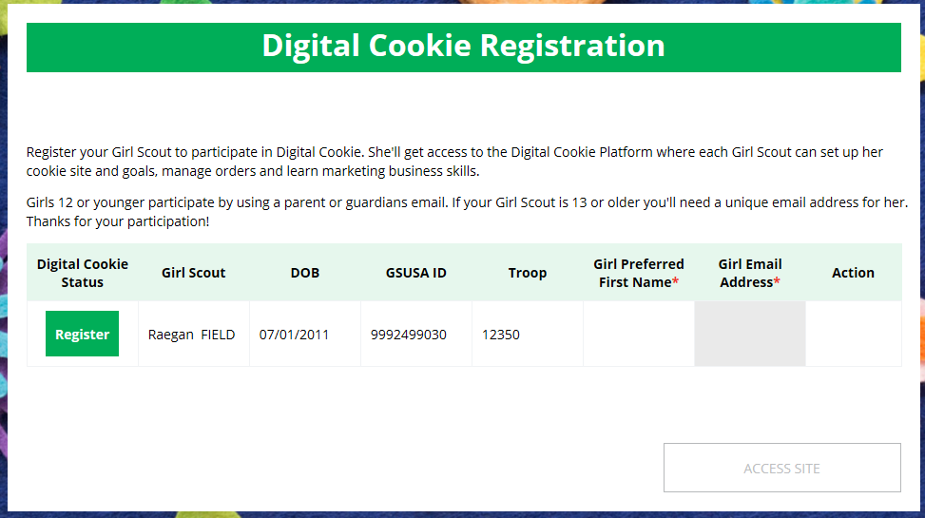
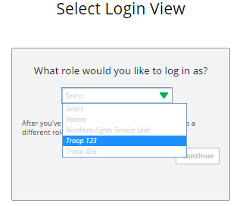
Step 1-Register
Sender: “Girl Scout Cookies” <email@email.girlscouts.org>
Subject: Register for the Digital Cookie platform today
1/12-Volunteer Registration email
1/19-Parent Registration email
Create Password/Login with password
View Safety Video/Approve Terms and Conditions/Safety Pledge
Select View/Register Girls
Notes:
You should have received a registration email like this. If you did not get one, first check your Spam or Junk folders; or, if you use Gmail, your Promotions folders. It might be there.
Click on “Register Now” – then you will get the screen to create your password and log in. You will get this login screen each time you go into Digital Cookie.
Parents must view the safety video with their girl(s), sign the Terms & Conditions for parent and read and sign the safety pledge with their daughters under 13. For girls 13+ - they need a unique email, not the parents’ email, to set up their site. (This does not have to be the girl’s real email address, but it must be unique and not in use on Digital Cookie) If a 13+ girl used Digital Cookie last season, she can use the same email. If a volunteer is also a parent, they will not receive a second registration email. They will be able to select the parent role and then complete the parent related steps. Next register the Girl Scout.

Slide 9
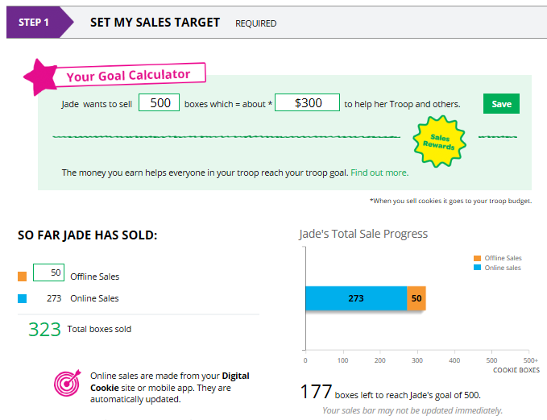
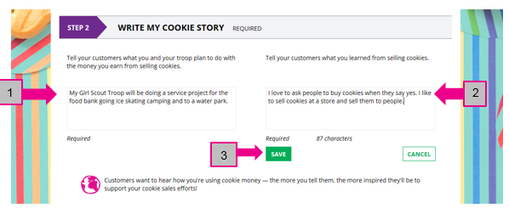
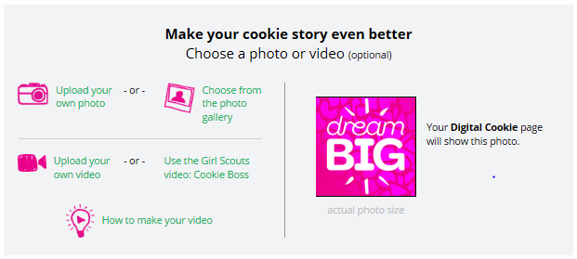
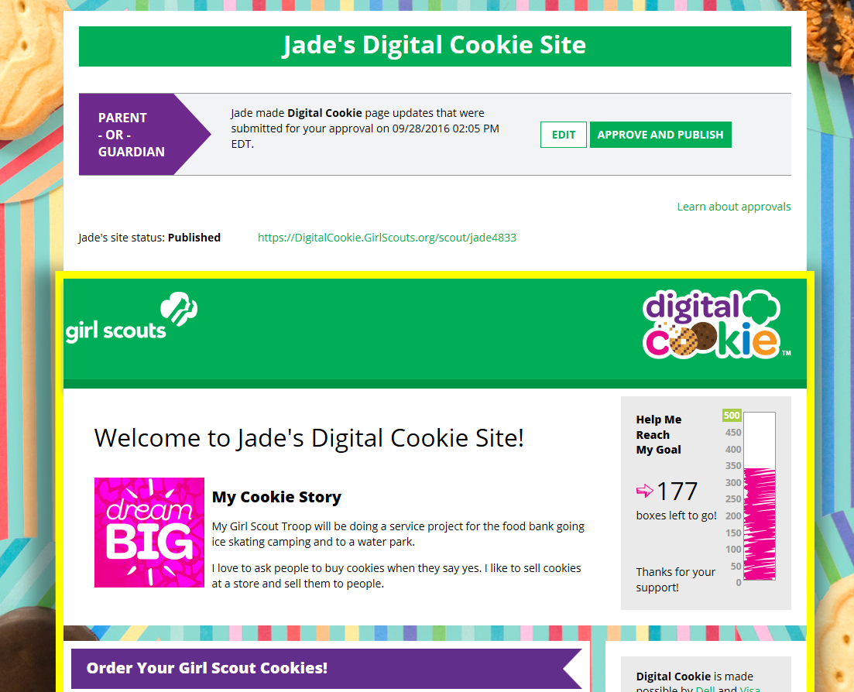
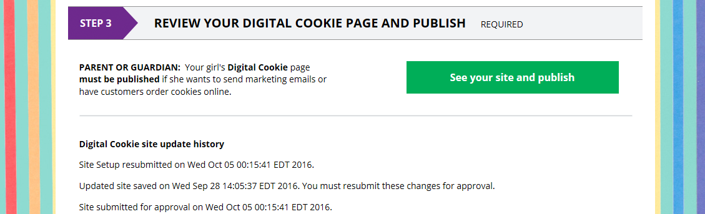
Step 2-Setup Your Site
2a. Sales Target/Offline Sales
2b. Cookie Story
2c. Photo/Video
2d. Approve and Publish
Notes:
2a: Girls need to enter their box goal (target) for all sales, not just Digital. Girls can then add their offline (order card) sales in DOC so it shows their total sales.
2b. For the Cookie Story, she will be prompted to enter her Troop goal and what she has learned, or hopes to learn, from selling.
2c. Upload personalized photo or video or use stock photo/video. Girls who use personalized photos or videos usually have better sales.
2d. Girls under 13, click green button and get taken to the site preview. Parent can EDIT or APPROVE and PUBLISH
Girls 13+ green button says “see your site and submit for approval”. They see preview and can edit. Parent is sent an email to approve the girl’s site. She logs into DOC, goes to the girl’s preview and approves it.

Slide 10
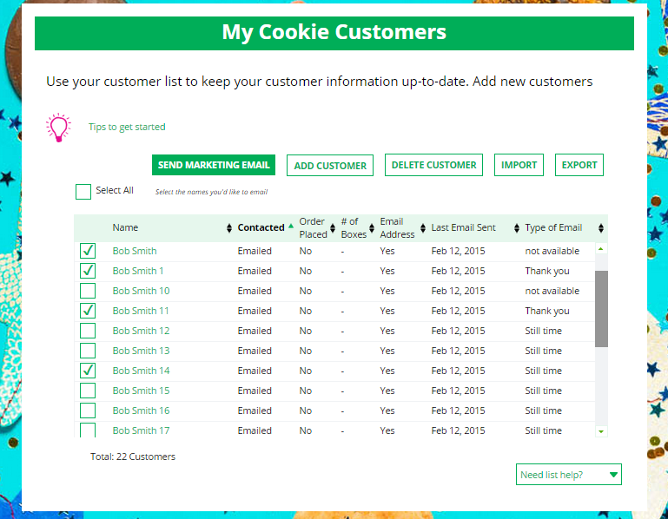
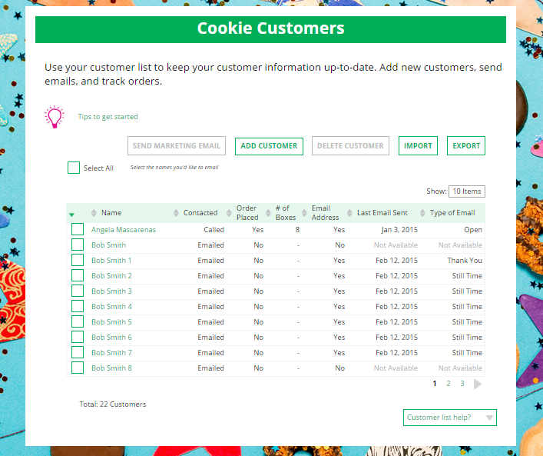
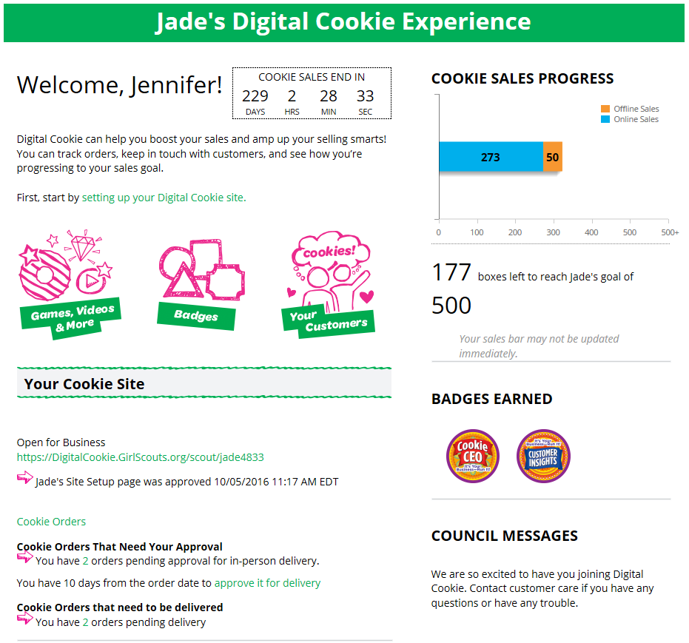
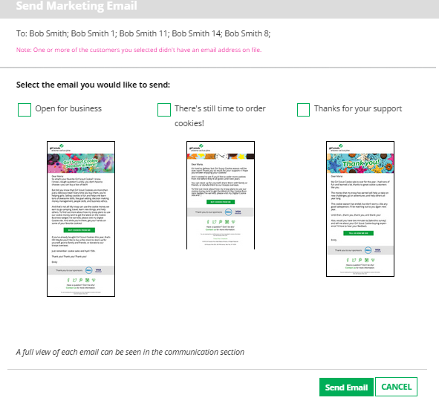
Step 3-Invite Customers (when cookie sales start)
Add or import customers
Send one of three marketing emails
Copy URL and email or share link (friends and family only)
OR
Notes:
Now we need potential customers. Girls can add customers individually or import a spreadsheet.
To send emails, click on box in front of customer name and click “send marketing email”. Select which email to send “Open for business” “there’s still time” “thank you”
Customer page updates with which email was sent and when. And/or you can copy Url

Slide 11
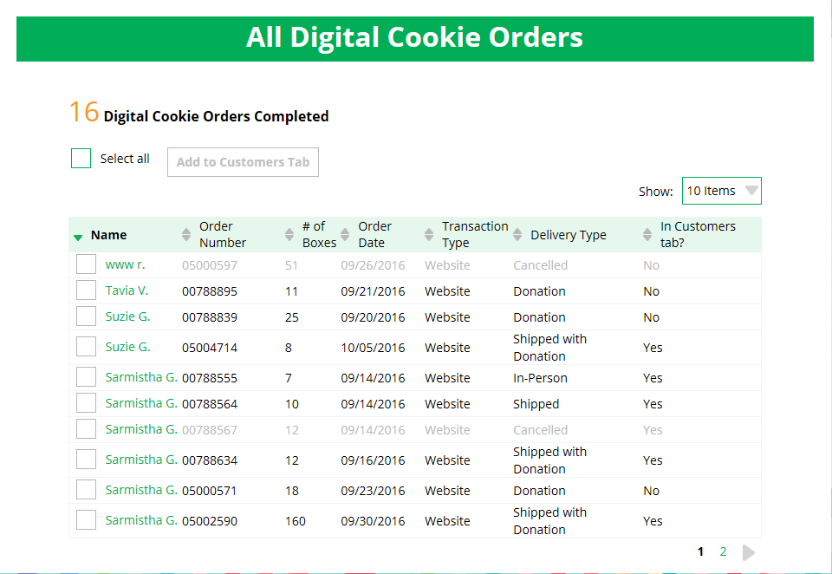
See the Results: Cookie Orders Tab
Notes:
This is part of the Cookie Orders Tab and shows Completed Orders. You can see if they were shipped, donated or for in-person delivery. Remember that in-person orders don’t show up here until they are marked “delivered” by the parent.
Parents get an email notification of in person orders that need approving and they show up on the Cookie Orders tab under “In-Person”.
Parents have 10 days to approve an order. Once approved it moves to the “delivered” section on the Cookie Orders Tab. Then, when it is marked as delivered by the parent, it moves to this screen – Completed Orders.
Clicking on the customer name brings up order details.

Slide 12
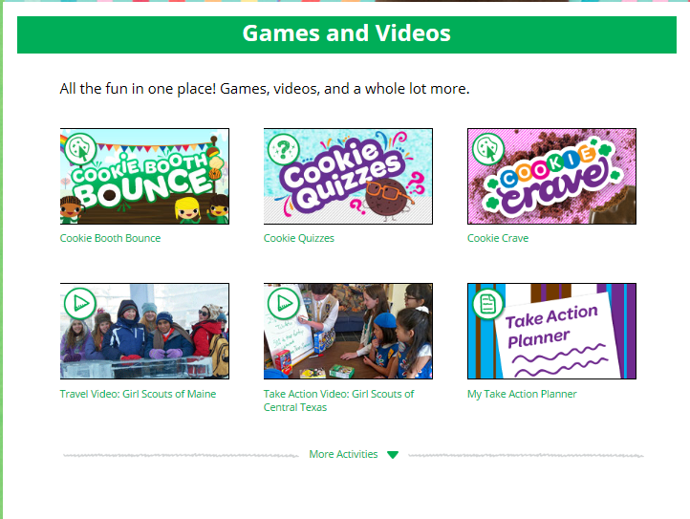
Digital Order Card-Games and Videos
Notes:
Games and videos are offered and what is offered varies by the age of the girl. Click on “More Activities” to see them all.
There is an average of 12/level
Girls LOVE the games!!

Slide 13
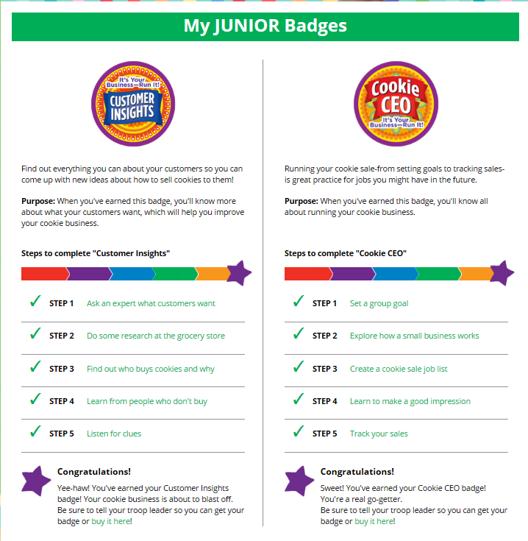
Digital Order Card-Badges
Notes:
Cookie business badges 2/age level (3 for Cadette). Girl clicks on step, completes it. Leader does not get info on what badges girls have completed. Parent needs to let leader know. Badges appear in color on girl home page once completed

Slide 14
Registration Issues-Self Help
Don’t Panic!
Notes:
Sometimes things don’t go smoothly! But help is available.

Slide 15
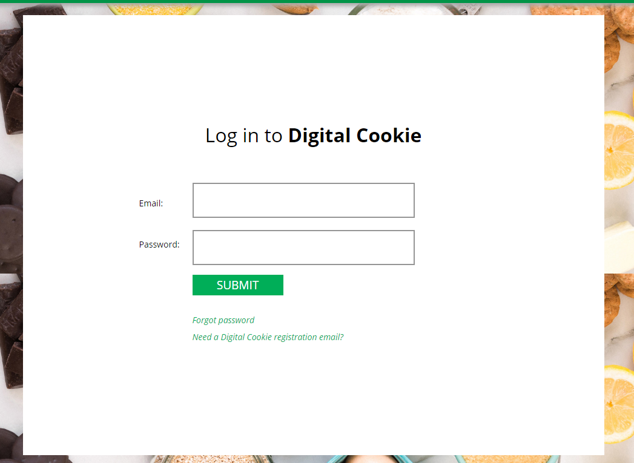
Troubleshooting Registration-Parent Self-help
I don’t have a Digital Cookie registration email.
Notes:
If you got the email, this is the login screen you saw You had to enter your email and set up a password and submit. Each time you log in you will do this.
If you have been in the site, but can’t remember your password, click on “forgot password. If you keep trying you will get locked out after 5 tries – so just click on “Forgot PWl”
If you didn’t receive the registration email, first check your Junk, Spam or Promotions folder, as I said before.
If it’s not there, you can google the Digital cookie site, get this screen and click on “I don’t have a Digital Cookie registration email.

Slide 16
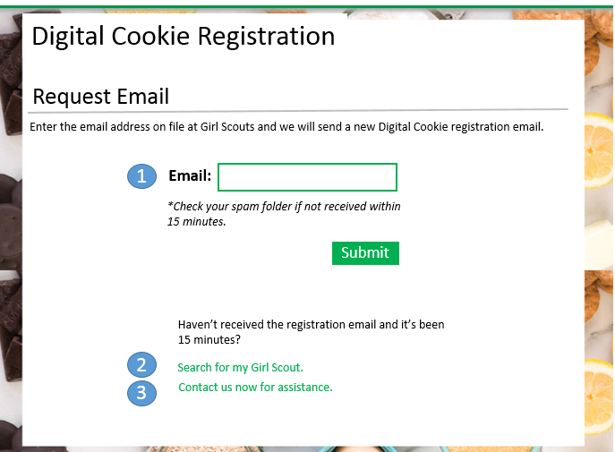

Option 2 - Girl Search: Search Page
Digital Cookie Registration
Search for Girl
Council Name*
First Name*
Last Name*
Troop ID*
*Required
Search
I don’t have all of the required details.
Notes:
Viola! You get this screen. You can put in your email address, wait 15 minutes and see if you an email. If you’re not that patient or if you are but you don’t get an email,
you can ‘Search for My Girl Scout” and complete the next screen and click on “Search”.

Slide 17
Option 2 – Girl Search Results Page
Digital Cookie Registration
Girl Scout Search
Council Name*
Louisiana East
Digital Cookie Registration
First Name*
Jennifer
<<search
Last Name*
Johnson
Girl Scout Details
Troop ID*
10979
Girl First Name:
Jennifer
*Required
Girl Last Name:
Johnson
Search
Parent Email:
abc***@gmail.com
I don’t have all of the required details.
Parent First Name:
Julia
Parent Last Name:
Johnson
Council must approve changes after they are submitted
Send Registration Email
Edit Details
Notes:
If your Girl Scout is found, you can click on “Send Registration Email” if the information you see is correct. If it isn’t, click on “Edit Detail”. Perhaps the email that shows here is an old one but wasn’t changed when you reregistered your Girl Scout. Or your name is spelled incorrectly – choose “edit details”. We at council receive a message and will see what you want to do, make sure it is a reasonable request and then make the changes and your email will be sent.

Slide 18
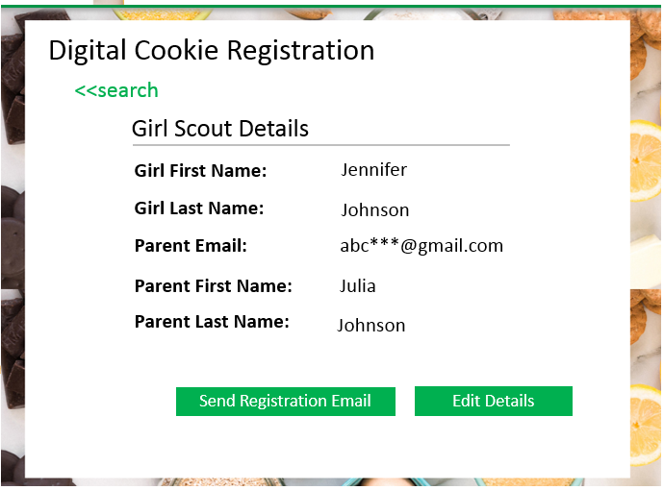
Option 2– Girl Search: Edit Details Page
Edit Parent Details
Girl First Name:
Jennifer
Girl Last Name:
Johnson
Parent Email:*
Parent First Name:*
Parent Last Name:*
*Required
Girl DOB:*
MM/DD/YYYY
Cancel
Submit
Notes:
You will get this screen and can change your email, and parent first and last name. Submit.

Slide 19
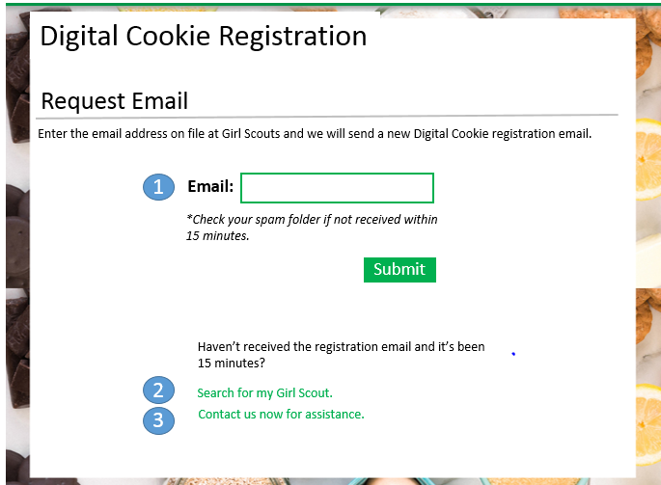
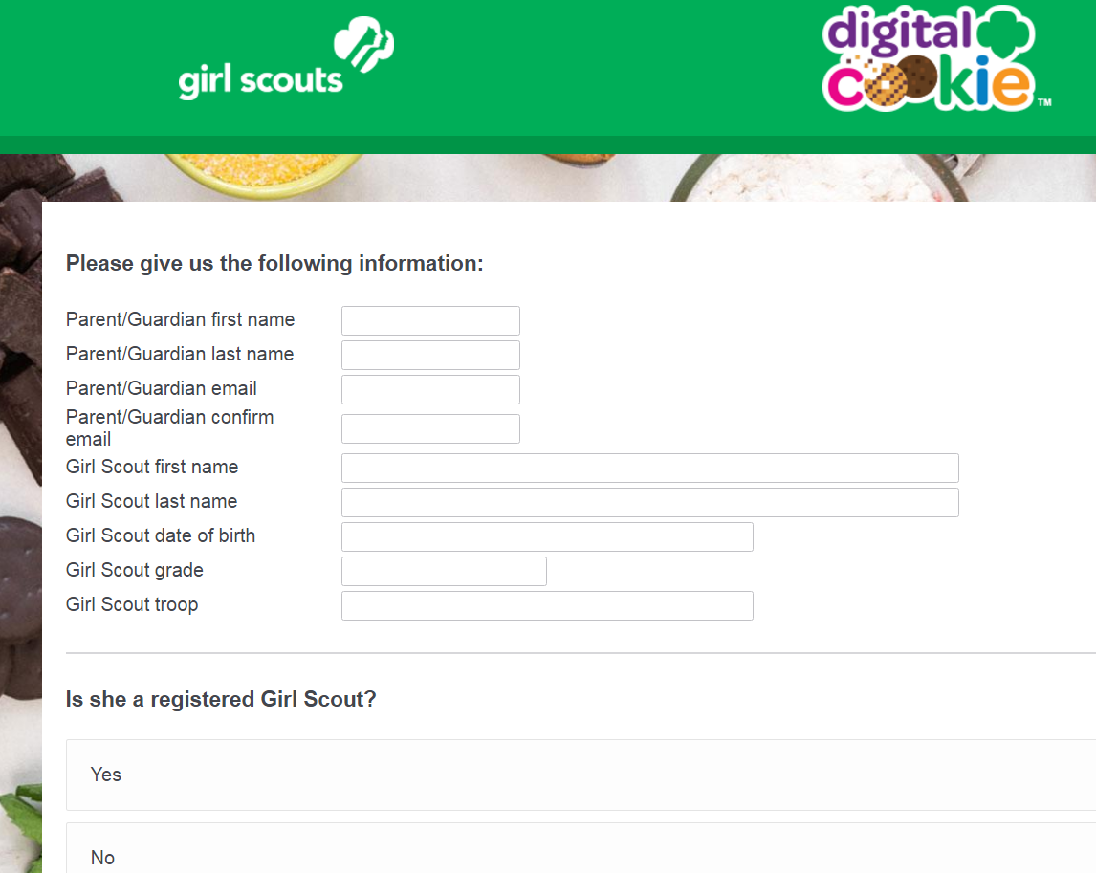
Option 3– Contact for Assistance
*Linking directly to the following form or revised GSUSA defined process:
https://girlscoutsusa.qualtrics.com/SE/?SID=SV_9NtMb6LuxrUGe0t
Notes:
Sometimes, those options might not work. Or maybe you just prefer to skip the Search and click on “Contact us now for assistance”. You will answer some questions and a form will be generated that will come to us and our Customer Care Team get the registration email out to you, or contact you for more information. Girls must be registered to receive a DOC email, so you could get an email or call telling you your Girl Scout did not register for this GS year.

Slide 20
QUESTIONS?
Give us a minute to check the questions.

Slide 21
Customer View
Placing an Order
Notes:
Let’s see some of what the customer sees.

Slide 22
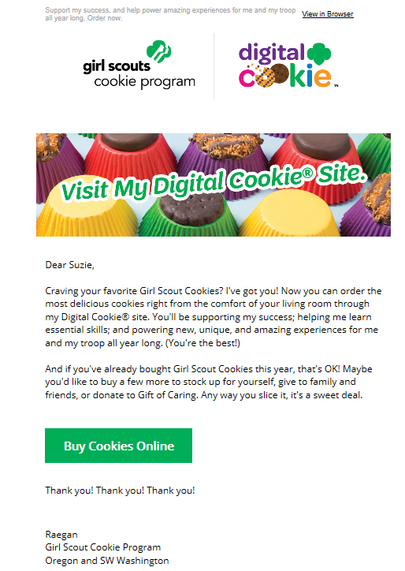
Customer View-Email
Notes:
Here is the customer’s invitation when they open the email.

Slide 23
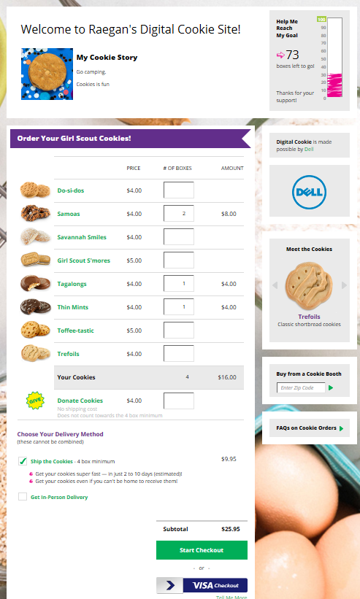
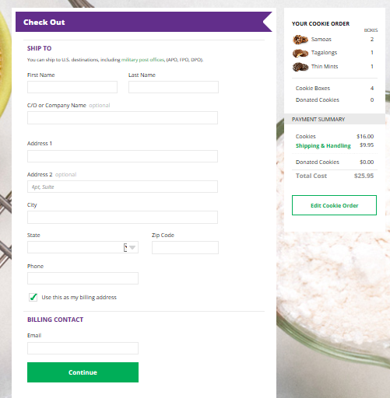
Customer View
Notes:
Customers see the order card and can click on “My Cookie Story” to see what the girl has to say about her sale and her goal. Customers can also see how close to the goal the girl is. Customers choose the cookies they want to order and/or can choose to donate cookies. Then they go to the Check Out screen. Simple.

Slide 24
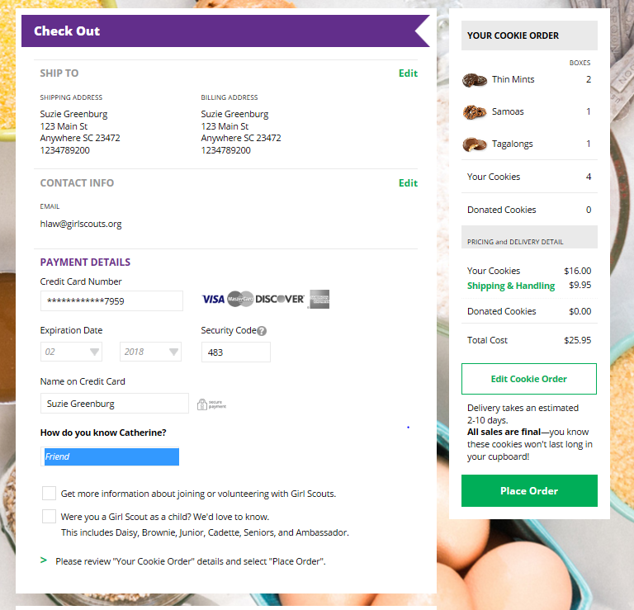
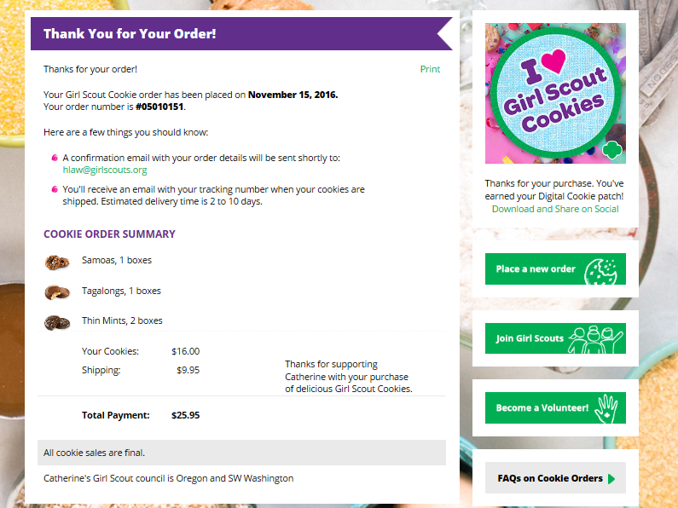
Customer View
Notes:
Customers enter credit card information and then click on “place order”
Customers receive a Thank You and confirmation of the order.

Slide 25
Troop Leader/SU view
Leaders – Be “in the know”
Notes:
The rest of the webinar is specifically for Leaders, Troop Cookie Chairs and SU Chairs. Parents you can certainly leave the webinar if you want.
Troop Leaders and Cookie Chairs can follow their troops’ progress in Digital Cookie.

Slide 26
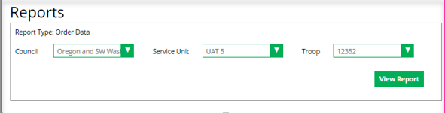
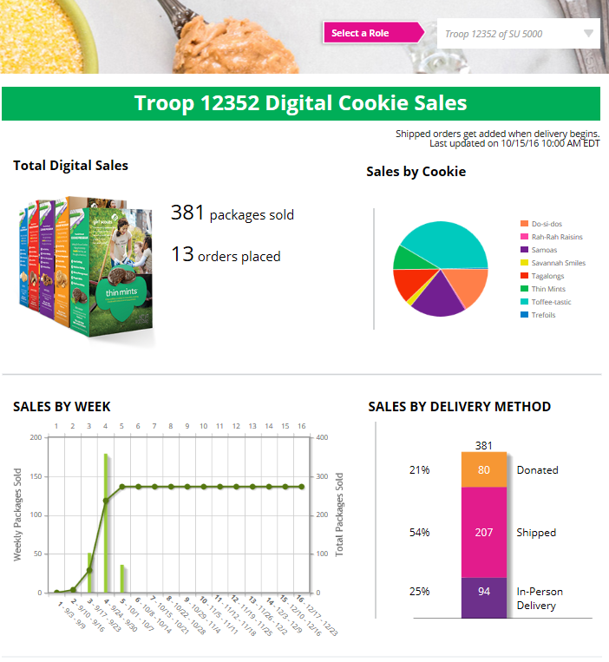
Troop Leader/SU View-DOC Dashboard
Metrics
Notes:
Volunteers can switch between the different roles they have at the top (select a role). So if you are a parent and a leader, choose the view you want to have by selecting the role. IF you are also a SU Cookie Chair, you have all 3 roles to choose from.
SU, Troop, and girl have the same elements on their dashboard. For SU, it includes metrics for all troops, for troops it includes sales for all girls.

Slide 27
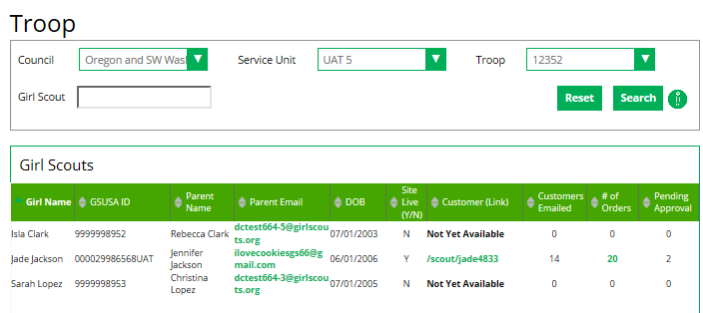
Troop Leader/SU View-DOC Dashboard
Notes:
This is a troop view and shows the girl information. You can see that Jade has her site up and ready, sent emails and has orders, 2 of which need approval.
The other 2 girls have not sent emails out yet. Once they do, it will show on this screen.

Slide 28
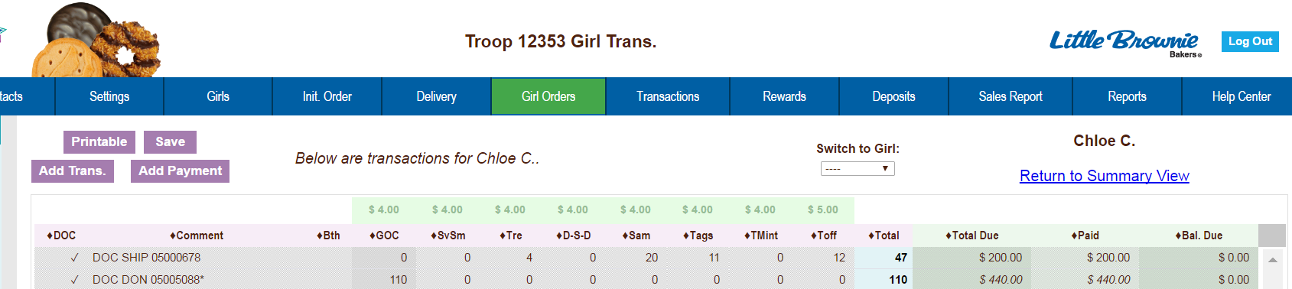
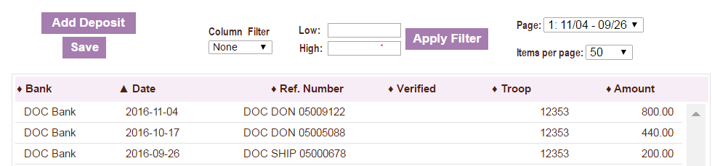
Troop Leader/SU Views-eBudde
Shipped Order
Deposits Tab
Notes:
Surprise!! - Now we are looking at eBudde.
This is how shipped and donated orders look in eBudde on the Girl Orders screen.
DOC Ship=Shipped order
DOC DON=Donated order
If there was an order that had both shipped and donated cookies, it would show as DOC Ship+
In-Person Delivery orders are not shown here but would say:
DOC DLVR=In-Person Delivery
DOC DLVR+=In-person delivery + donated order
In person delivery orders are financial transactions only in eBudde. No boxes are assigned to the girl, only the amount paid. The boxes will need to be ordered, as part of her initial order and will be part of those totals.
This screen shows how the payments look in the Deposits screen.

Slide 29
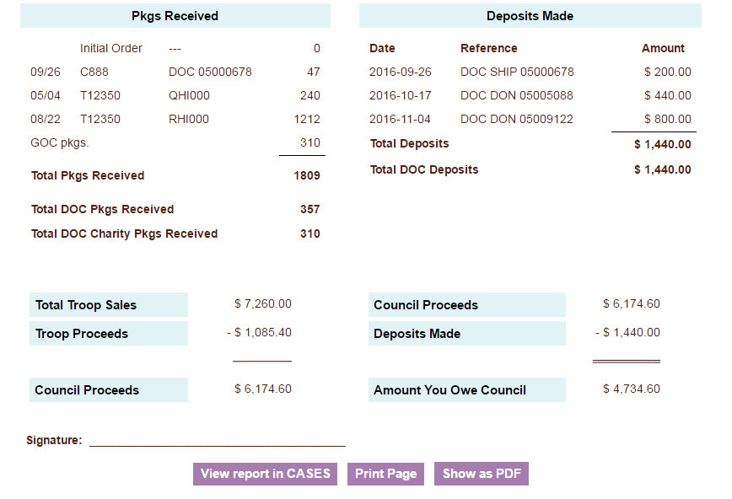
Troop Leader/SU Views-eBudde
Sales Reports
Notes:
DOC orders appear on the Sales Reports under Pkgs Received. Donated orders do not appear on this side because they were not received by anyone.
All payments for DOC orders appear on the deposits tab and in the Deposits Made column on the Sales Report
“Amount You Owe Council” is the final amount the troop owes. The deposits for Digital Cookies have been accounted for. The profit from Digital Cookies is included in the “Troop Proceed” figure.

Slide 30
QUESTIONS?
Give us a minute to check the questions.

Slide 31

THANK YOU for making a difference for girls.
Notes:
We appreciate your time tonight. Parents & Caregivers – have fun helping your Girl Scout get the most out of her cookie sale experience!
Volunteers – we appreciate all you do for the girls! Thank you and good night.

