Slide 1
Notes:
We know that this graphic is hard to read, but it’s a great summary of the sale and you can find it in the family Guide and troop Cookie book on our website. Here you see the many ways that girls are able to sell cookies. All registered Girl Scouts with a signed permission slip can participate in the Cookie Program! This slide is also available on our website and in the Troop Cookie Book. We have a few handouts that you can download. They include the Troop Cookie Book, The Family Guide, a flyer on Troop Cookie Links, Important Dates and the Troop Permission slip.
The Girl Scout Cookie Program is the largest girl-led entrepreneurial program in the world and girls learn five key skills they will use for a lifetime:
Goal setting: She sets cookie goals and makes a plan to reach them.
Decision-making: She decides how her troop will spend the cookie earnings.
Money management: She makes a budget, takes orders, and handles customer’s money.
People skills: She learns to talk and listen to all kinds of people while selling cookies.
Business ethics: She is honest and responsible every step of the way.
Your time and talents are valuable to girls and to the Girl Scout Cookie Program. Thank you for helping build a program where girls learn, grow, and make a lasting impact on the world.

Slide 2
we are ready to…
This Girl Scout Cookie Season,
2
CONFIDENTIAL & PROPRIETARY
Notes:
Thank you for joining us for the 2023 Cookie Program.

Slide 3
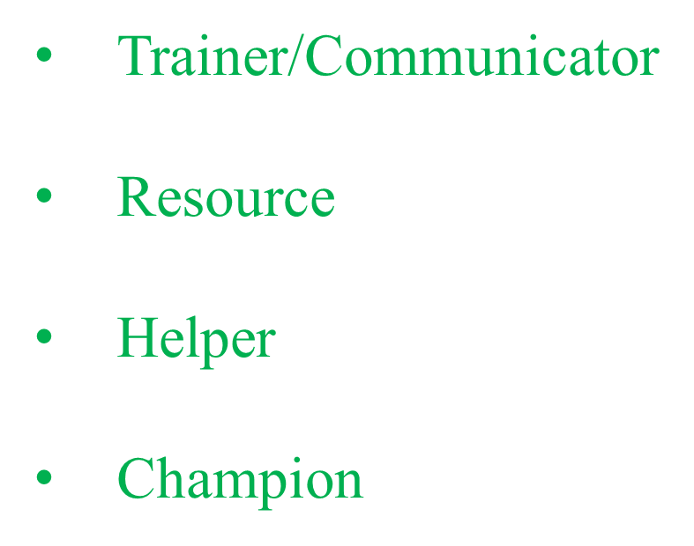
3
Notes:
Training is crucial as it ensures your girls are ready to take on the cookie season. For families, you are the information source for all things cookies – from distributing key program materials to directing them to helpful resources. As helper, you assist with and respond to families who have issues or concerns. The cookies season is a joyous, but sometimes hectic time of year. You are the troop’s #1 cookie supporter. So take time to re-energize them throughout the sale.

Slide 4
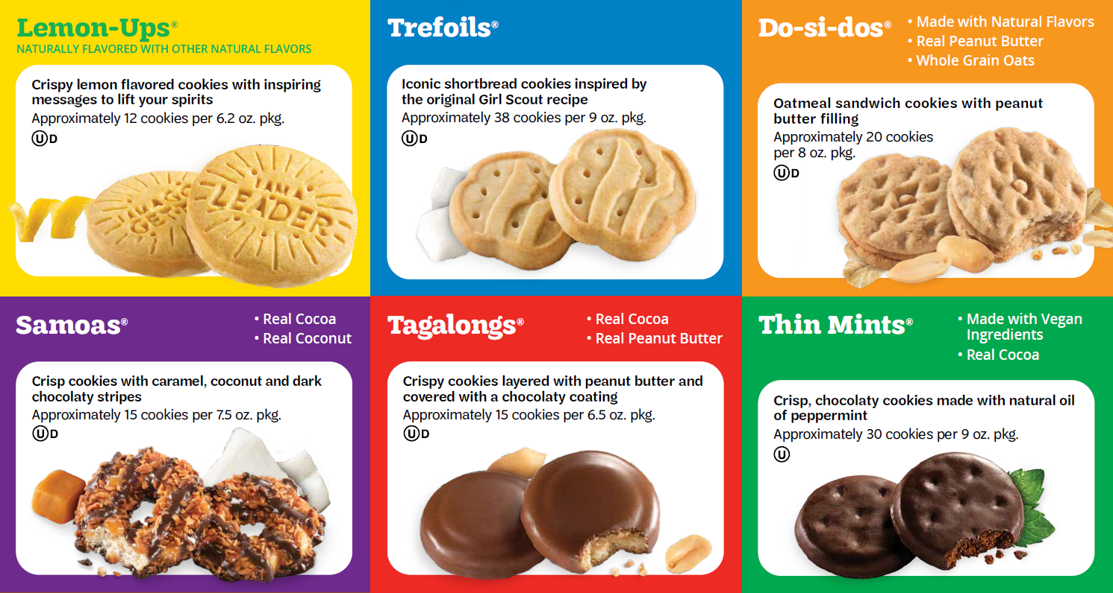
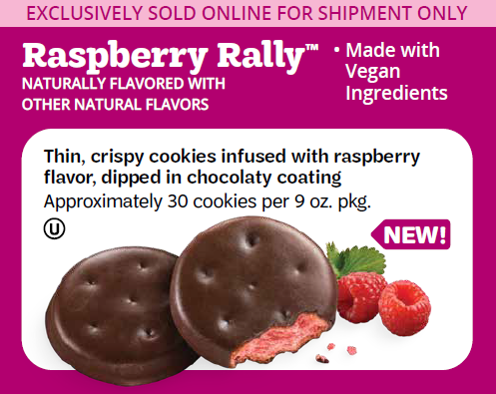
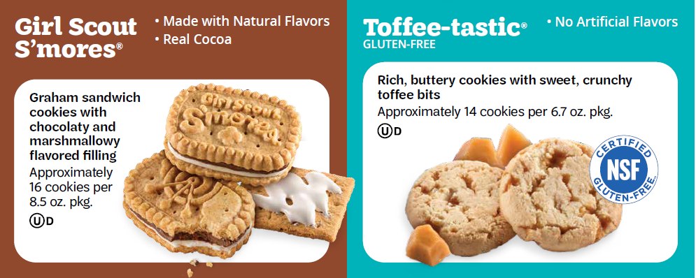
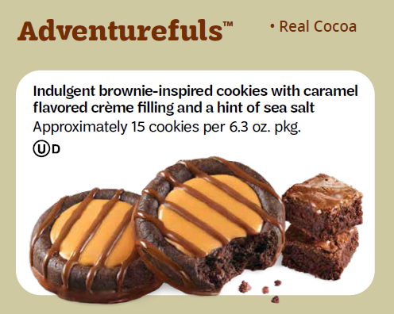
Our 2023 COOKIE LINEUP
Notes:
Cookie prices remain the same as last year. New and exciting cookies (Raspberry Rally and The Adventurefuls) are part of the $5 core. The S’mores and the Toffee Tastics are the only two that are part of the specialty cookies at $6 each.

Slide 5
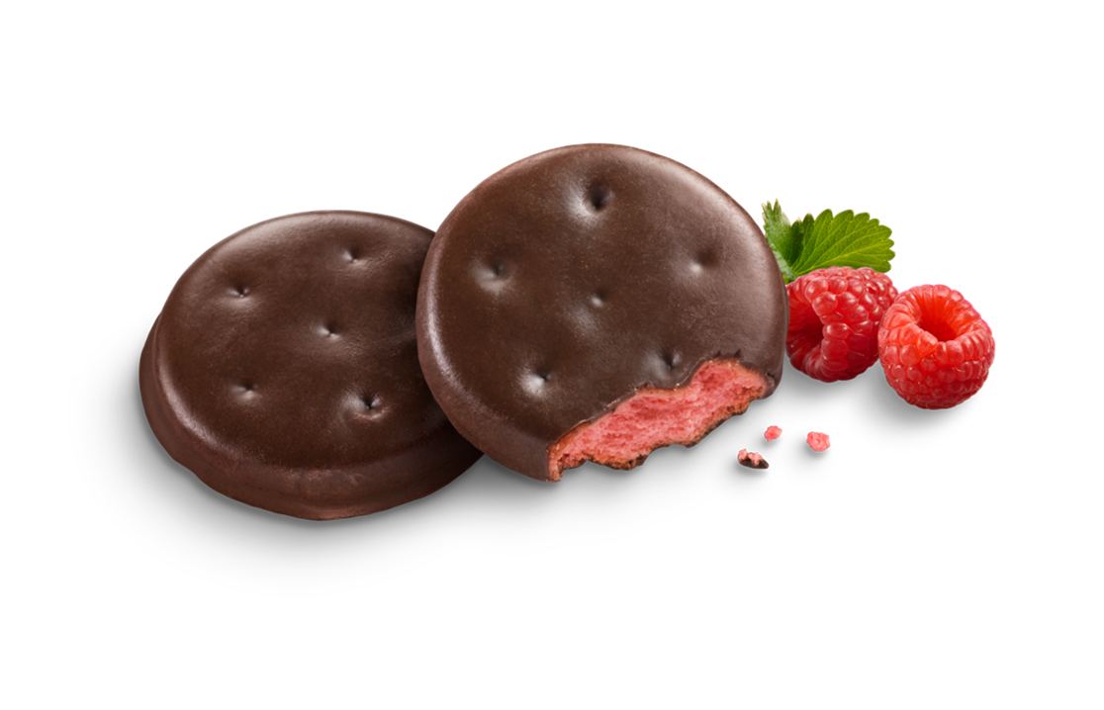
Raspberry Rally™
The first Girl Scout Cookie offered exclusively online for shipping only!
Simplicity for volunteers and girls, no handling necessary
Easy inventory management
Opportunity for girls to learn about and participate in rapidly growing online shopping trends, and practice omni-channel selling skills
Raspberry Rally featured on the bottom, not with the other cookies
Notes:
Consumers are craving raspberry – a growing flavor among sweets and cookies in the U.S.
Thins, as a concept overall, remain compelling in the market (Brownie Brittle, Oreo Thins, Chips Ahoy! Thins, Tates, Thinsters),
appealing to both Cookie Lovers and Life Balancers with an opportunity to bring new consumers into the Cookie Sale.
Plum colored package to build on fun, delicious raspberry color and flavor,
Clear sweet raspberry aroma that is distinct from chocolate.
Bright pink base cake to contrast with dark brown coating.
Flavor delivers on consumer expectation of raspberry.
Package similar to Thin Mints:
2 sleeves of cookies in carton
9oz net weight
12 cartons/case

Slide 6
Hooray for Cookies!
Initial Order phase 2/10-3/26
Digital Cookie opens for volunteers 2/3, for families 2/9
Goal Getter 3/27-5/14
Booth sales
March Booth sales 3/10-3/26
Regular Booth sales 4/21-5/14
FPO
Notes:
Hooray for Cookies! We’re so happy to be back on track with our Girl Scout Cookie sale. Girls can take digital orders for donation and for girl delivery starting Feb 10. Digital will be open for shipping starting Feb 27.
The cookie sale is comprised of 3 distinct phases in specific timeframes. We will go through each phase on the next slides.

Slide 7
Initial Order 2/10-3/26
Girls go door to door, or connect personally with customers to take orders on the girl order card.
Digital Cookie open for customers.
Special rewards for girls and troops
for orders taken during this period.
Notes:
Initial order is the first phase and usually the biggest portion of the sale. Girls take orders and troops enter the order into our cookie management system, eBudde. More about eBudde later.
Social media is very helpful to let friends and family know that girls are taking orders—and can be a key part of the troop’s plan for selling cookies in every phase.
Girl’s Cookie orders must be entered into eBudde by 3/28 . The troop then will choose a location and time to pick up cookies. Cookies will be delivered between April 20-22. Troop orders go into eBudde and are ordered by the case—one dozen packages are in a cases.

Slide 8
Troops must place their order in eBudde, entering girl order card orders by March 28th by 12 noon. All varieties are “cased up” into cases of 12 packages Webinar for Troops: Initial Order, Step by Step March 22, 7PM
Ordering Initial Order Cookies
Notes:
eBudde has very real deadlines and troops are locked out by the stated deadline - March 28th at noon.
After all the girls’ orders are entered, eBudde will round up to the nearest 12, and order cases of cookies. The troop is responsible for all the cookies they receive. Goal getter—later sales—and booth sales can help sell extras you might have.
We will have a live webinar on 3/22 to take you thru the actual screens to enter your sales. The webinar will be recorded and posted on our GSHH website.

Slide 9
Important Dates
eBudde access end of January
Digital Cookie access February 3 for volunteers
Family DOC access, February 9
Cookie sale begins February 10
Initial Order Ends March 26
Troops Submit I/O March 28
Notes:
There will be a full list of important dates in, the troop cookie book and on our website. These are just some key dates. eBudde access for volunteers end of January:
Digital cookie access begins on February 3rd for you.
Parent access to DOC begins on February 9th.
The cookie sale officially begins on Friday, February 10th which is also when digital cookie opens for selling.
The initial order period ends on March 26th and troops must submit by Monday, March 28th.
DOC-Digital Order Card opens for girl delivery and donation February 10th and shipping is on February 27th.

Slide 10
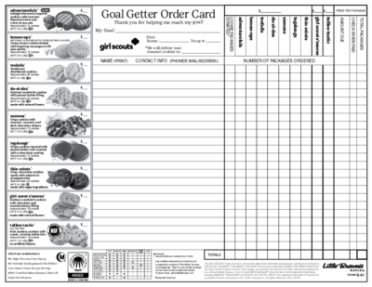
Goal Getter
Notes:
Goal getter sales immediately follow Initial order. This phase allows girls to keep selling, or gives girl who did not sell during I/O a chance to catch up. There will always be a customer who says “I wish you told me you were selling cookies!” This gives girls a chance to catch those customers and fill their order. Goal Getter orders can be filled using extras from the troop’s initial order, from the cupboard, or by transfer from another troop.
Goal Getters give the troop the possibility of making up for lost time, or achieving goals they did not meet during I/O.
We recommend that when girls turn in their color order cards to the troop cookie chair, they also hand the girl a Goal Getter order card.

Slide 11
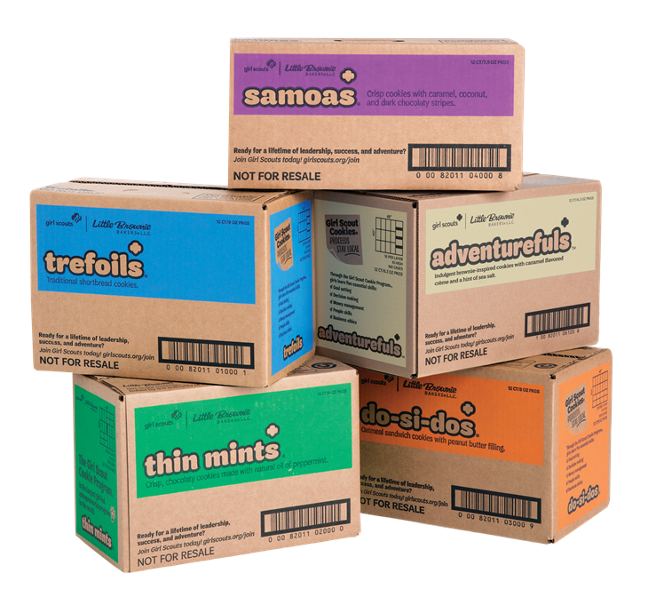

Slide 12
March Booths
2022- Preseason
3 weekends March 10th-26th
Troops can enter “My Sales” booth locations
Council arranged locations will be in eBudde
Order cookies by February 9th
→ Choose cupboard desired for pickup
→ Choose quantities
Notes:
March booth sales are from March 10 through the 26th. We honor Girl Scout ‘s birthday month with early booth sales so Girl Scouts can get out and tell their GS story. As in previous years, we will be using the Pre-Season tab in eBudde to order the cookies and reserve council booth locations. Please stay tuned for the list of council booth spots that we will have for March. We will announce via eBudde and HH when eBudde will open up for booths.
Palisades, Westchester Mall, JV Mall, Poughkeepsie Galleria, Poughkeepsie Plaza, Crystal Run, Newburgh(tentative), New City Shop, Wappingers Shop.

Slide 13
How do I get more cookies?
Cupboards at GSHH offices or in outlying areas (see eBudde or website)
Cookie Exchange tab in eBudde
Notes:
There are many times you will need more cookies – people asking if you have them, GOAL Getter orders, booth sales, and maybe even for orders girls did not get to you in time to order for your troop delivery. Council has a cupboard in every office and there are outlying cupboards in some communities. All cupboards will be listed in eBudde and on the GSHH website.
Troops can get more cookies at cupboards and the orders do not have to be placed in cases—one could pick up a single package if that’s what is needed.
If you need to place an order for more cookies, you can order them in eBudde and pick them up a the cupboard most convenient for you. eBudde will have a list of cupboards and details about hours, locations, etc. There are even maps to show where the cupboards are. For March booth sales we will have the office cupboards, Kingston, Carmel, Cortlandt Manor, Hyde Park and cupboards open and as many of you know we are working on securing additional cupboard locations to fit the needs of more communities.
eBudde’s cookie exchange tab can also help identify troops that may have extras that they would like to transfer to another troop, perhaps saving you a trip!

Slide 14
April/May Booths 4/21-5/14
Please enter your troop-arranged Booth Sales in eBudde—help people find you in Cookie Finder!
Booth sales
Boost troop profit
Gives girls chance to get to higher reward level
Helps SU get closer to SU Cookie Bonus

Slide 15
Questions

Slide 16
Notes:
Digital Cookie is a girl’s online cookie store. She can use this to tell customers about her Girl Scout experience and share her link with friends and family. Families love it because they can spread the news far and wide that it's cookie season and customer love it because they can make their decisions any time they open the link.

Slide 17
Digital Cookie (DOC)
Opens for volunteers 2/3
Opens for families 2/9
Girls can begin selling on 2/10
→Site open for girl delivery, donations
Shipping option opens 2/27
→Raspberry Rally—available for shipping only--
order taking begins 2/27
→All varieties available for shipping
FPO
Notes:
This year the Digital site will have phases. The first to open is for girl delivery and donation. Later in the month-- Feb 27—the shipping option opens. We suggest that girls who have customers who usually order cookies to be shipped, approach those customers on or after February 27th when the shipping option becomes visible.

Slide 18
Digital Cookie should be part of every girl’s cookie plan
Orders placed in DOC during Initial Order load into girl totals→ become part of troop order
Girl Delivery option through May 10; orders placed after Initial Order must be credited to the girls, added into Girl Orders. Troops must arrange to fill order at cupboard, from extras, through Cookie Exchange
Orders for shipped will open on February 27
Notes:
Digital Cookie is the online cookie sale channel for the Girl Scout Cookie Program. Girls and troops can set up personalized cookie sites that can be shared with friends and family.
Digital Cookie continues to grow in usage and can be part of almost all selling methods.
Cookies can be ordered and paid for online by the customer.
Multiple delivery methods are available including girl delivery or direct ship.
The option to ship directly to a customer’s home allows girls the opportunity to sell to family and friends across the country!
Shipping fees are paid by the customer and the customer is informed up front to cost of shipping before placing the order.
Donated and shipped orders are touch-free transactions, customers can support the girl . This year Shipped cookies will be available beginning February 27th.
Prepaid orders--Girls Reach customers with a link, not at the door or workplace. Girls can arrange for safe place deliveries, customer appointments for pickups that girls load cookies into car trunk,
More on troop links is next!

Slide 19
Troop Link
Notes:
Link One: The Troop Cookie Link
• This link does it all! Customers can order cookies for local delivery by girls in your troop or have cookies shipped. For local sales within your troop’s delivery area, customers place their order and the troop delivers the cookies to the customer’s address with support from an adult.
• The troop can also use this link to take pre-orders that allow customers to pre-pay and pick up at a troop designated location. This designated location could be an existing cookie booth, a drive through location or another public location designated by the troop. Your troop can work together to reach troop goals in new ways using your Digital Cookie Troop Links.
Link Two: The Troop Shipped Only Link
• Use this link when selling outside of your troop’s delivery area in the community.
• Customers can purchase cookies that are shipped directly to a recipient or donated to your council’s cookie donation program and credited to your troop.
• Once your troop sets up this link, it will be connected to the Girl Scouts of the USA Cookie Finder and customers from anywhere could end up using your direct ship link to buy cookies that support your troop. The great news-there is nothing additional to do... cookies are shipped directly to the customer and the troop shares the sales with all the girls in the troop at the end of the season.

Slide 20
Rewards 2023

Slide 21
Troop Proceeds
Troops earn 90 cents per box
Additional 5 cent bonus for troops who achieve 150 PGA on Initial Order
Some girls earn additional 5 cents for membership early bird reward
NEW! Opt Out for C/S/A troops and C/S/A Juliettes with 150 PGA
Notes:
Opt Out of Rewards Option for older girl troops Older girl troops (Cadette, Seniors and Ambassadors) that attain a 150 PGA can choose to opt out of rewards and earn an additional 10¢ per box. The whole troop must agree to not receiving rewards and the troop must submit all the girls signatures on the Opt Out of reward form. Opt out form due by 2/24/2023 If girls opt out, they will receive all the patches associated with levels detailed on the order card but none of the other items. They WILL receive $25 Dough Si Dough at the 200 box level.
If the troop chooses to opt out and does not attain a 150 PGA, the troop will receive rewards as shown on the order card.

Slide 22
Rewards 2023
Rewards are cumulative—girls earn at every level they achieve
Choice of reward or Dough-Si-Dough at several reward levels beginning at 200+ packages
Troops MUST select each girl’s choice
I/O Rewards are shipped to SUCC in time for delivery
Final rewards are shipped at the end of cookie sale
Notes:
We gave the girls choice of Dough-Si-Dough at levels from 200 packages and up.
Please emphasize at your training and remind leaders before final rewards are due that they MUST indicate what each girl wants at each level.
All girls that sell 150+ packages will receive $25.00 DSD great for membership, program registration, and in our shops and so much more.

Slide 23
Opt Out Rewards Option
New this year for Cadettes, Seniors and Ambassadors
Older Girl Troops that achieve a 150 PGA during Initial Order can earn 10¢ more per box
Details:
The entire troop must agree to not receive rewards and must sign the Opt Out form.
Opt Out Form must be submitted to Council by Feb 24th.
Troops opting out will receive all the patches associated with
levels on order card, but none of the other items.
Girl WILL receive $25 DSD at 150 package level (only).
If troop doesn’t attain a 150 PGA, troop will receive rewards as shown on order card
New!
FPO
Notes:
This is an exciting reward offered to older girl troops! Troops will earn 10 cents more per package if they achieve a 150 troop PGA in I/O and submit the Opt Out form by February 24th.

Slide 25
UNIQUE REWARDS for a bright new season
COUNCIL insert your Rewards Panel here
Fun, new charm patches for DOC sales, 125+, 150 packages
Dough Si Dough option starting at 150 packages
New Opt out option for Cadettes, Seniors, Ambassadors
Notes:
Dough Si Dough is another part of GSHH’s rewards design. Dough Si Dough has an assigned value and can be used in our GSHH shops for Program, Camp, camp trading post, or for a girl’s registration. DSD is sent by email in June directly to the girl ‘s caregiver address.
Our PGA goal to receive $25.00 DSD is 150. We hope our reward items at that level will incentivize younger girls to reach this goal.
We hope that the new option for the older girls for Opt Out will give them the option for new opportunities.

Slide 26
Questions

Slide 27
Money Matters
Bank accounts and Balances
Troops must have a bank account to participate
Troops must have an ACH authorization on file
SUCCs are responsible for ensuring that troops
have a zero balance by sale’s end
Troops with a balance from last year will not be
permitted to participate in 2023
Notes:
All troops must have a bank account. There will be three ACH sweeps where a third of the amount owed will be debited from the troop account. Troops should deposit money often into the troop bank account.
ACH dates 1st – May 11th , 2nd – May 25th, and final June 8th.
You should fill out the Outstanding Cookie Balance form that will be on the website if needed at any point in the season.
The troop should give receipts for all transactions. Fill out a receipt each time money or cookies are exchanged. Parents are responsible for all Girl Scout cookies and money received. Have parents, not girls, sign receipts. Make sure adults count cookies before signing receipt.
Count money in front of parent before signing receipt.

Slide 28
ACH dates May 11th - 1st ACH 1/3 amount owed May 25th - 2nd ACH 1/3 amount owed June 8th 3rd - ACH remaining balance

Slide 29
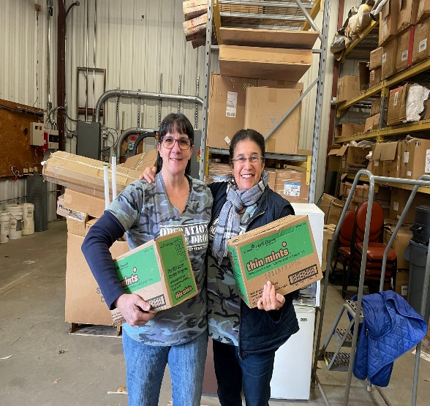
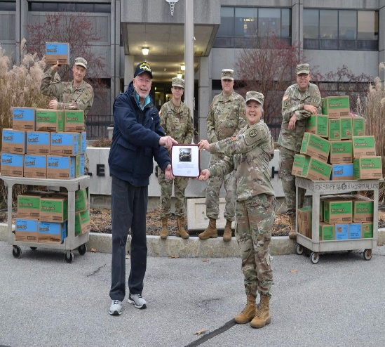
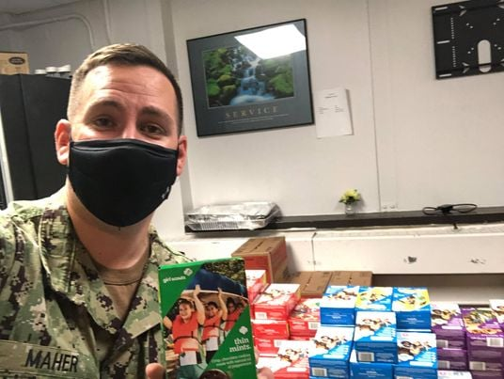
Operation Cookie Drop
Girls sold over 100,000 packages last year
Encourage troops to ask for donations to Operation Cookie Drop
Troops can share their Troop Digital Cookie Link for donations
Load-In Event is TBD
Notes:
Our program, Operation Cookie Drop, is headed by an amazing volunteer Alison Bergman who has coordinated donation shipments by Navy ships, Air Force flights, and so many other avenues of distribution! The boxes go to bases across the globe, to veterans, hospitals, Honor Flights.! We’re asking you to emphasize that many people would like to support the girls but don’t want the cookies, this program benefits both the girls and our Armed forces and veterans!
Customers can donate on the order card in Digital Cookie and troops should set up a donation box at their booths. We have very generous neighbors and we know our girls can make this happen! In 2022, GSHH collected more than 100,000 packages for our military.

Slide 30
eBudde
ebudde.littlebrownie.com
Notes:
eBudde is your friend and ours! This is your cookie management tool

Slide 31
Using eBudde
Troop Leaders are uploaded into eBudde by council.
Troop Cookie Chairs must be added to eBudde by Customer Care. Must have:
-- background check
-- current registration as a Girl Scout
Troop Cookie Chairs should contact Customer Care to be added.
Notes:
All users get an email with a link to set up a password.
All users must enter their contact information once in eBudde.
Important – Troop Cookie Chairs Must be Registered and have a background check. Leaders should email MC(MemberCare) and MC will get the Chairs into eBudde after confirming registration and background check.

Slide 32
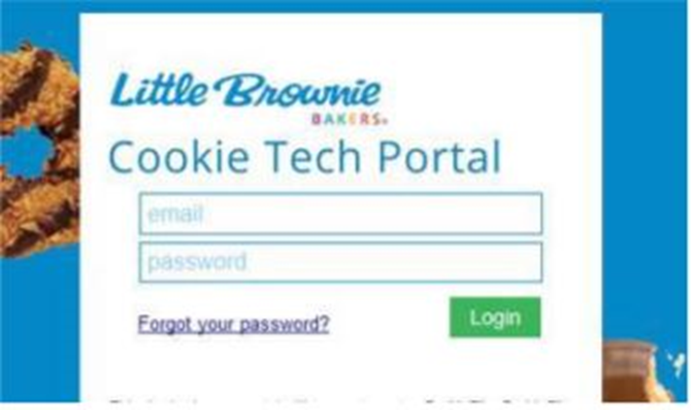
Initial Log In
User receives welcome email with login link.
Click on the link.
At the login screen, enter your email and password.
At the profile screen, enter password that you used in Step 3. Also review/enter all additional information.
Enter Little Brownie Cookie Tech Portal system.
Confirm account update via email link. Your Troop Dashboard will appear.
Notes:
This is how to proceed from the link. If you didn’t go to the eBudde.littlebrownie.com

Slide 33
Supporting You: Using Your Resources
Council webinars
Lunch and Learn webinars
Microburst trainings LBB Videos in eBudde “help” tab
GSHH Headlines & Happenings
Leader Agendas
Notes:
We have resources that you can use.
Troop Cookie Book has detailed calendar and specifics about the whole cookie sale. You can download the book from the GSHH website on the For Volunteers page.
Troops should check the website for videos, recorded webinars, and Q&A’s. We have a couple of webinars on specific topics already scheduled. We will add to these and add other things on the website as the season moves along.
Headlines & Happenings goes to all Leaders weekly. We will often put reminders or pertinent information in it.
Also, the SU Agenda from Council often includes information for troops.

Slide 34
Communication supports success
Your Service Unit Cookie Chair (SUCC) is your primary contact
Read eBudde email, check eBudde dashboard messages
Utilize any communications tools
Individual emails, use eBudde’s Contacts tab to email families right from the site
Share your contact information
Troops can contact Member Care with questions
Notes:
Communicating with families is an important part of your role. Agree with families on a communication method (email, phone, text, Facebook group, etc.). Check in with your families regularly to keep everyone involved. In eBudde, you can reach out to your families by sending an email. Recognize that, like you, everyone is busy so it’s wise to limit how often you send out emails.
Our Member Care Team is ready to help you. They will be prepared with answers to all the common questions – and some not so common! If they don’t have the answer, they will pass on the question to the Product Sales Team.
BTW eBudde emails look different, almost like junk mail, since they look different they are easy to recognize.

Slide 35
Delivery

Slide 36
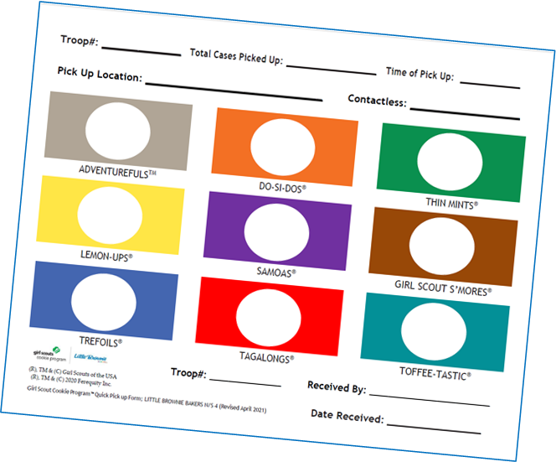
Delivery
Delivery between April 20th -April 22nd.
Council enters delivery date/ times/locations
in eBudde. Check message on dashboard late March.
Troops can set up appointments once dates/locations are in eBudde (March 27, 2023)
Notes:
Delivery dates
We will enter the dates and time in eBudde and set up the sign-up sheet.
Council will set up delivery locations and times for troops to choose from. It will most likely be most of the same locations as we had last year.
Council will continue to take the lead on delivery, with most sites GSHH-owned. McCollisters will not be a cookie delivery agent this year, so their warehouse in Poughkeepsie will be replaced an announced at a future date.

Slide 37
Delivery
Follow these guidelines for a smooth cookie pickup day:
Know exactly how many cookie cases you ordered of each variety.
Arrive at your scheduled pickup time.
Make sure to have enough vehicles to load your order. See graphic below for help!
Have your eBudde delivery confirmation with case count.
Count as cookies are loaded into vehicles.
Confirm the count is correct before signing for your troop's cookies. Your troop is financially responsible for these cookies.
Vehicle Type | Case Capacity
Compact Car | 1-23
Standard Sedan | 20-45
Standard Wagon* Standard Pickup** | 45-70
SUV/Minivan* | 50-100
Standard Van | 150-200
Notes:
.Please arrive on time. Please make sure that you have the right size vehicle for your troop’s orders. If you are not available to pick up on the delivery date please make sure that another adult from your troop is able to do so. And always count, count and count again!

