Slide 1

How to Distribute Cookies to Girls from the Troop Site

Slide 2
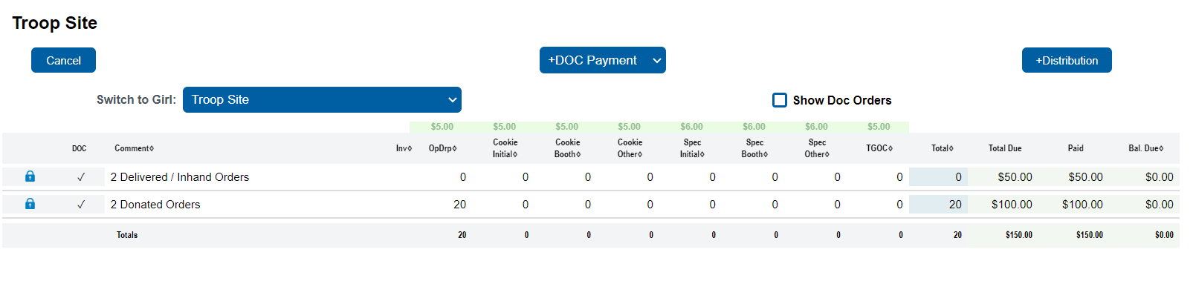
Here are some steps you should take with Troop Site Orders:
1. Determine which Girl Scouts will receive credit
2. Log into eBudde
3. Select the Girl Orders tab
One of the Girl Scouts listed with your troop on the Girl Orders tab will have the name “Troop Site.” If you have a large troop, you may need to scroll through the names, which are listed alphabetically by first name.
Select this “girl” and you will see the orders that have come to the Troop Link. These we need to allocate to Girl Scouts.
1. If you have something to distribute, you will see the +Distribution button in the upper right (it will not appear if there is nothing to distribute/allocate).
2. In the sample below, there are 2 Donated and 2 Girl Delivered/ Inhand orders to allocate; click the +Distribution button, which opens a screen where you can indicate which Girl Scout(s) is/are to receive packages

Slide 3
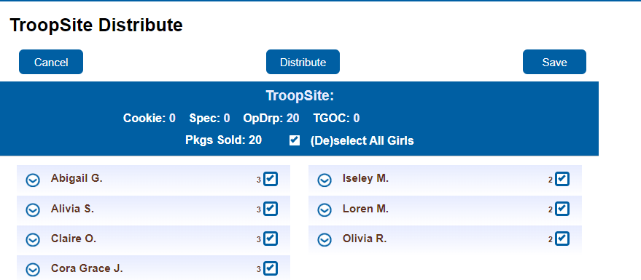
All packages from this distribution will be listed at the top of the page by quantity. All Girl Scouts will be selected by default. eBudde will assign packages evenly (as near as possible if the amount sold is an odd number) based on the number of Girl Scouts selected. You can see the number of packages distributed to individual Girl Scouts next to their check boxes. Click on Distribute and eBudde will distribute the packages as evenly as possible.

Slide 4
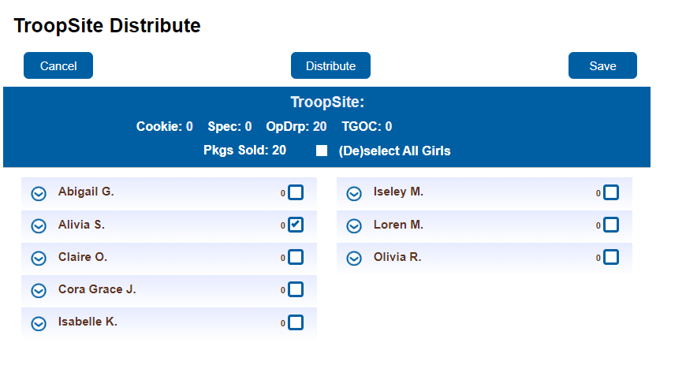
If you want to manually edit individual distribution to Girl Scouts, you can uncheck the
(De)select All Girls box and select the girls you want to Distribute to.

Slide 5
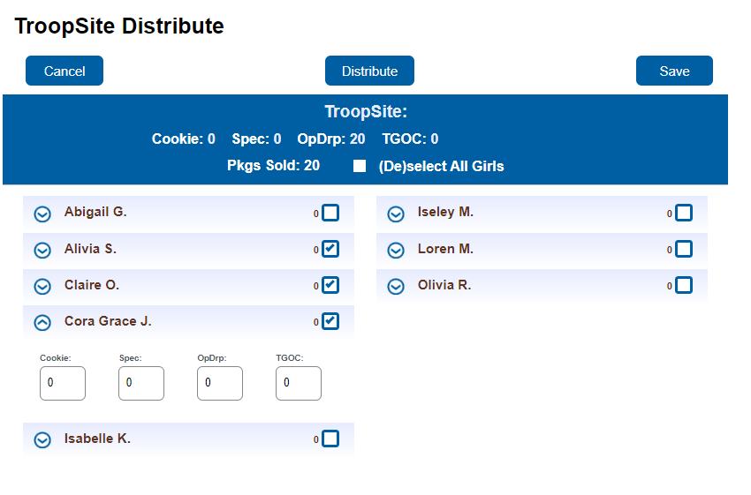
If you want to manually edit individual distribution to Girl Scouts, you can uncheck the
(De)select All Girls box. Then select each Girl Scout for this distribution by checking the box
beside their name. Select the drop-down menu for each Girl Scout you are allocating to and add
the package quantities you want to give each Girl Scout.

Slide 6
Once all selections have been made you click Save at the top and the packages will be
distributed to the Girl Scouts in the quantities selected. Package quantity may not exceed the
packages sold amount.

Slide 7
Once Save has been selected, eBudde will create an EDITABLE row for the distribution so you
can see that the distribution was completed. You will also see that the +Distribution button
disappeared. That is because you do not have any more packages to distribute. If you get more
DOC Shipped Orders, you will need to do another distribution.

Slide 8
Allocation of Money from a Booth site.

Slide 9
You will always need to balance the payment amount, as there is a balance (monetary entry) for
delivered orders. Click the +DOC Payment button in the “TroopXXXXX Site” “girl.” In this example, this allocation of money will be at a Booth site.

Slide 10
This will take you to the booth site selection tab. Select the booth you will allocate money to.
Select Record Sale.

Slide 11
The Booth Sale Recorder page will open. Enter the value in the box labeled Digital Cookie
Payment. Click Go to Distribute.

Slide 12
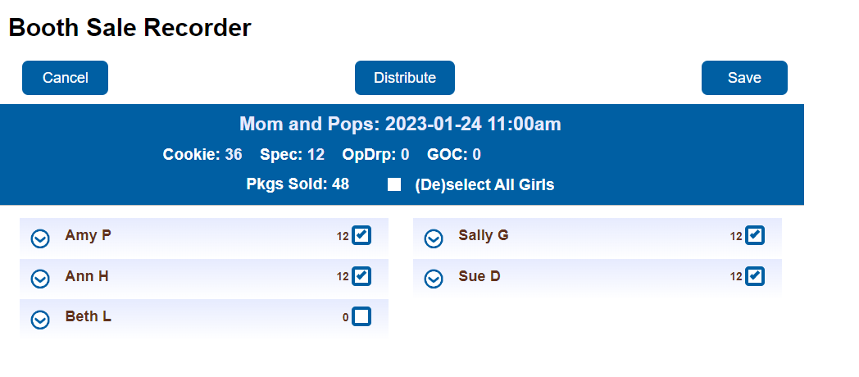
Select the girls that participated and click Distribute then Save

